Slide 1
Introduction to Cypress
Date: 23rd Feb 2026
Duration: 2 hours
Presenter: Vishnu Shankar

Slide 2
Agenda
Introduction
Cypress vs Selenium
Core Features
Cypress Architecture
Setup Guide
Folder Overview
Writing Cypress Tests
Cypress Runner UI
Troubleshooting Common Issues
Key Takeaways
Hands-on Practice
Q&A

Slide 3
What is Cypress?
Purpose-built for modern, dynamic JavaScript applications
Fast, stable, and easy to use
Runs inside the browser → more accurate tests
Test Runner provides step-by-step interactive debugging
Supports multiple browsers and all major frontend frameworks
Simple installation with powerful built‑in tools (screenshots, videos, auto-waiting)

Slide 4
Cypress vs Selenium
Architecture: Cypress runs in the browser; Selenium uses WebDriver APIs
Waits: Cypress auto‑waits; Selenium requires manual waits
Setup: Cypress is simple; Selenium needs more configuration
Languages: Selenium supports many; Cypress supports JS/TS
Reloads: Cypress has real‑time reloads; Selenium doesn't

Slide 5
Key Features
Auto‑waits for elements → no flaky timing issues
Time‑travel debugging → visually inspect each step
Real‑time reloads → instant feedback as you code
Strong error handling → clear, actionable errors
Detailed logs & reports → screenshots, videos, and step logs

Slide 6
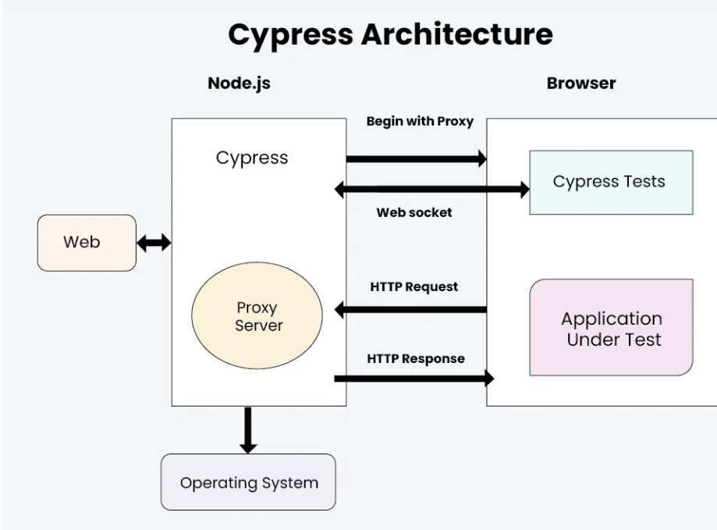
Architecture
Runs inside the browser alongside the app’s event loop
Access to UI + network + backend logic simultaneously
No WebDriver → simplified, faster, more reliable
Interactive Test Runner with step‑by‑step visual debugging

Slide 7
Setup Guide
Install Node.js as the runtime environment
Install Cypress using npm install cypress
Launch Test Runner using npx cypress open
Write tests inside Cypress spec files
Automate test execution in CI/CD pipelines

Slide 8
Folder Overview
Integration/E2E: Contains test spec files
Support: Custom commands and reusable utilities
Plugins: Node-based plugins and event handling setup
Fixtures: Test data (JSON files, mock data)
Screenshots/Videos: Auto-generated evidence for reports

Slide 9
Writing Tests
Use describe() blocks to group related tests
Use it() blocks for individual test cases
Add hooks (beforeEach, etc.) for reusable setup logic
Selectors (CSS, data attributes) interact with DOM elements
Assertions validate UI behaviour and expected output

Slide 10
Runner UI
Displays complete list of tests and specs
Shows real-time execution in the browser
Supports snap-step (time-travel) debugging
Provides detailed logs with reporting support

Slide 11
Limitations Of Cypress
Limited browser support (no Safari/IE)
No multi‑tab or multi‑window testing
No native mobile app testing
Only supports JS/TS
Restricted OS‑level interactions
iFrame handling is limited
Network stubbing is simulated, not real
Parallel execution needs external setup
Headless debugging can be tricky
DOM‑heavy apps may slow tests

Slide 12
Troubleshooting In Cypress
Quickly resolve timeout issues using clear error messages
Address browser-specific failures with multi-browser support
Debug selectors and file paths using time‑travel snapshots
Use logs, screenshots, and videos to maintain stable, reliable tests

Slide 13
Key Learning Points
Learned Cypress basics.
Explored architecture deeply.
Built and ran practical tests.
Understood debugging w/ UI.

Slide 14
Hands-on Practice
Run live Cypress tests and observe real-time execution
Validate outcomes and debug using snapshots & logs
Add configurations, scripts, and environment settings
Explore and create reusable custom commands

Slide 15
Conclusion & Next Steps
Continue hands-on learning.
Explore official documentation.
Apply knowledge in scaling!

Slide 16
Q&A
Open session for questions and discussions.

